Slide 1
DevOps
ADOP Gen5 Activities Day1

Slide 2
Course Map/Module Map
Quality Gates
CI - Jenkin
SCM - GIT
Cloud Formation
Module Map
Configuring Sonar
Checking Cucumber Reports
Performance Reports using Gatling
Module Map
CI Pipeline Execution
Check Output
Observe Configuration
Module Map
Download and Install GIT
Project Creation
Branch Management
Module Map
Generation of Key Pair
Copying Lab material
Creating Stack
Observing Servers

Slide 3
Module Objectives
At the end of this module, you will be able to:
Create DOA gen5 stack using cloud formation
Use GIT as SCM for your project
View and use Jenkins as CI tool
Describe the Quality Gates in a pipeline
Notes:
Action verbs: abstract, acquire, adjust, agree, analyze, apply, appraise, argue, assess, avoid, breakdown, build, calculate, carry out, catalog, clarify, classify, combine, compare, compute, conclude, construct, contrast, convert, cooperate, create, criticize, defend, define, demonstrate, derive, describe, design, detect, determine, differentiate, discover, discriminate, discuss, dissect, distinguish, employ, estimate, evaluate, examine, explain, explore, formulate, generalize, help, identify, illustrate, implement, indicate, inspect, instruct, integrate, interpret, investigate, join, judge, justify, label, list, master, measure, move, name, observe, offer, operate, order, organize, participate, perform, plan, praise, predict, prepare, produce, propose, rank, recall, recognize, relate, repair, represent, reproduce, research, restate, resolve, select, sequence, solve, specify, state, summarize, support, systematize, taste, test, theorize, transform, translate, use, utilize, verify, weigh, write, etc.

Slide 4
Module 1 Activities: Cloud Formation

Slide 5
Introduction
This activity aims at creating the environment required to execute the remaining activities
It used AWS cloud to create virtual environment

Slide 6
Key Pair Generation
Note:
This is one time activity for trainer
Participants need not to perform this activities
Login to AWS
Click on EC2 link (left top corner)
Click on Key Pairs under “Network & Security”
Click on “Create Key Pair” button
Provide some name in the box
Click on “Create” button
Save the downloaded .pem file for use in module7
Share key name and .pem file with participants

Slide 7
Cloning Lab Material
Pre-requisite
Installation of GIT
Create folder to store training material e.g. DevOpsAcademy
Open the folder, right click and select “Git Bash Here”
On GIT command prompt, type
“git clone https://github.com/Accenture/adop-doa-materials.git”
This will copy the lab material inside your folder

Slide 8
Cloning Lab Material Continued…
Note:
This is a one time activity for trainer
You can get material cloned before session
This material can be directly shared with participants if needed so that participants need not to clone it
Files to share with participants
<key_name>.pem
adop_doa_material
.chef.zip (Participants can also create it themselves)

Slide 9
Stack Creation
Login to AWS console with given link, userName password
In the top-right corner, change the region to EU (Ireland)
From the list of AWS services, click on CloudFormation under "Management Tools"
(Hit CTRL+F to search for CloudFormation if you can't see it)
Click on the blue Create Stack button

Slide 10
Stack Creation Continued…
On the Select Template page:
Select the Upload a template to Amazon S3 option
Click on "Choose File"
Browse to DevOpsAcademy/adop-doa-materials/Standing_Up_Tools
Select the file "doa_stack.json" and click "Open"
Click: "Next"

Slide 11
Stack Creation Continued…
On the Specify Details page:
Provide value for Stack name section
Decided naming convention for stack is as
<IDC_LOCATION>StackName e.g. MDCPrachiStack
Provide value for UserName & Password
You are not allowed to use "admin" as a username
Password must be 8 characters long and should contain alphabets and digits
Provide values for AwsAccessKey and AwsSecretKey as per email
Select the key you created for KeyName parameter

Slide 12
Stack Creation Continued…
On the Options page:
Under tags, Create a tag with the following values (Optional):
Key: CreatedBy
Value: <YOURNAME>
Click: "Next“
On the Review page:
Review the template details
Review the estimate the cost of infrastructure
Click: "Create“
Give it some time and watch the Events

Slide 13
Observing Servers
CloudFormation scripts produce outputs after the stack has been created successfully
Clicking on the "Outputs" table will provide you with the EC2 instance created
Note the public IP of your instance
From AWS console select EC2 service and click Running Instances
Search for your instance by typing your stack name
To check details of the instance, select the instance

Slide 14
Observing Tools
Use the public IP address provided under output tab of your stack to open ADOP home page
Provide userName and password you entered while creating the stack
Click on Jenkins link to observe Jenkins tool
Click on Gerrit link to observe Git and Gerrit
Click on SonarQube link to observe Sonar tool
Browse around but do not change any configuration

Slide 15
Challenges
Stack creation failed with reason “Maximum number of VPCs reached”
Delete unused VPCs
Refer to document (Credits: Sumit Arora)
Template giving error while creating the stack
Check the availability zone on top right corner of AWS page
It must be EU Ireland zone

Slide 16
Module 2 Activities: SCM: Git + Gerrit

Slide 17
Introduction
The activity aims in providing an introduction to SCM tools like Git and Gerrit.
Git is a version control system and repository to maintain the code and its versions
Gerrit is a code review tool and can be integrated with CI pipeline

Slide 18
GIT Installation
Perform this activity in case not done in first part
Download GIT from
https://git-scm.com/download/win
Start installation
Select Git Bash and Git GUI
Select “Use Git from windows command prompt”
Keep remaining options as default
Click Install button

Slide 19

Login To And Browsing Gerrit
Go to your Gerrit server: http://<Server-Public-IP>/gerrit/
This link is available from ADOP home page also
Click 'Sign in' in the top right corner of the screen
Sign in using the UserName / Password you specified in previous activity
Click "Projects" and then click “List” to browse available projects

Slide 20
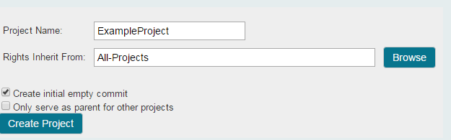
Creating New Project
Click "Projects" and then click "Create New Project“
Type in the project name, for example ExampleProject in the "Project Name" field
Type "All-Projects" in the "Rights Inherit From:" field
Check on the "Create initial empty commit" checkbox
Click "Create
Project"

Slide 21
Creating a Branch
Click on the "Projects" link
Click on the "List" link
Click the ExampleProject that you created earlier
Click on Branches
Type "develop" in the Branch Name field.
Copy the SHA Hash for "master" and paste it into the "Initial Revision" field
Click "Create Branch“

Slide 22
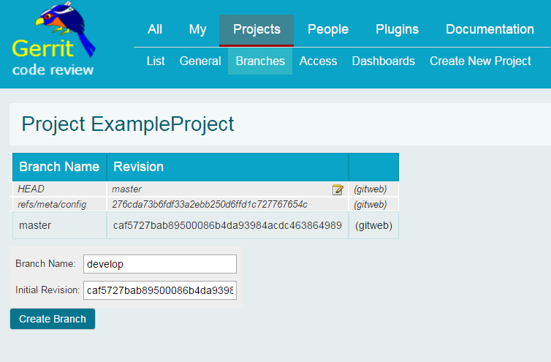
Creating a Branch

Slide 23
Populating a Repository
Clone the empty sample project you created in the previous step
Clone command can be found in Gerrit on the top of project
git clone http://<user.name>@
<public-IP>/gerrit/ExampleProject
Change to your Gerrit repository directory
cd ExampleProject
Switch to the develop branch
git checkout develop

Slide 24
Populating a Repository Continued...
Copy the contents of the "Sample_Source_Code" (provided within adop-doa-materials - Lab_Modules/Module_2) folder into the "ExampleProject" folder
Move to git and write following commands
git add .
git status
git commit -m "Adding sample project contents "
git push --set-upstream origin develop
git push --set-upstream origin master

Slide 25
Challenges
Pushing the changes gives merge issue
Type git pull
Open the file and check what is the issue
Correct the file
And follow the sequence
add, commit and push

Slide 26
Challenges
Websense seems to be causing a lot of issues with git pushes
Typically the error will say something about a host "blackspider“
In that case simply disabling Websense seems to work
Go to control panel, administrative services, and disable Websense service

Slide 27
Topic 3
Module 3 Activities: CI: Jenkin

Slide 28
Introduction
Developer checks their source code changes into version control
Jenkins detects a change and automatically runs any build steps defined in the build job – these can be compilation, test execution, packaging of artifacts, etc...
Jenkins reports back on any build errors encountered
Developer immediately fixes coding error and checks code back into version control

Slide 29
Code Change & Pipeline Triggering
Clone the petclinic project from Gerrit
git clone http://<user.name>@<public-ip>/gerrit/DOA/Labs/Module2_Module3_FOSS_Java/spring-petclinic
Move to spring-petclinic directory
cd spring-petclinic/
Create and switch to the development branch
git checkout -b develop master

Slide 30
Code Change & Pipeline Triggering
Make a change to the code
e.g open to
spring-petclinic/src/main/resources/
messages/messages.properties
and change "welcome=Welcome" to "welcome=Welcome to my petclinic!“
Commit and push changes
git add .
b.git commit -m "Updated welcome banner"
c.git push --set-upstream origin develop

Slide 31
Code Change & Pipeline Triggering
Merge the changes to master
git checkout master
git merge develop
git push

Slide 32
Watching Pipeline
Navigate to the ADOP Jenkins pipeline
DOA→Labs→Module2_Module3_FOSS_ Java→Java_Reference_Application
View the new build and watch it progress through the pipeline
Once the Reference_Application_Deploy job was successful (green), navigate to the CI environment to view the deployed application
http://DOA_Labs_Module2_Module3_FOSS_
Java_CI.<public-ip>.xip.io/petclinic

Slide 33
Application Deployment
The set of instructions will include
How to configure Jenkins to automatically deploy an application
One click manual deployment process
Updating deployment file

Slide 34
1 and 0 Touch Deployment
Navigate to the ADOP Jenkins pipeline
DOA→Labs→Module3_FOSS_ Java_Manual→Java_Reference_Application
Click on Run option to start the pipeline
Step “Reference Application Deploy” is configured as manual step and will not start automatically
Application will not be available at
http://doa_labs_module3_foss_java_manual_ci.<public_ip>.xip.io/petclinic/

Slide 35
1 and 0 Touch Deployment
Click the jenkins job 'DOA/Labs/Module3_FOSS_Java_Manual/Reference_Application_Code_Analysis‘
Click the "Configure" link on the left hand navigation panel
Scroll to the bottom of the configuration page
Click add "post-build action" button
Click "Trigger parameterized build on other projects"

Slide 36
1 and 0 Touch Deployment
Replicate the data from “Build Other projects (manual step)” step
Project: DOA/Labs/Module3_FOSS_Java_Manual/Reference_Application_Deploy
Trigger build when
stable, unstable but not failed
Add predefined parameter
B=${B}
PARENT_BUILD=${PARENT_BUILD}

Slide 37

1 and 0 Touch Deployment
Delete the "Build Other projects (manual step)" action using the delete button
Save the configuration
Click on Run option to start the pipeline again
Observe the pipeline
Deployment will happen automatically
You will be able to access application using
http://doa_labs_module3_foss_java_manual_ci.<public_ip>.xip.io/petclinic/

Slide 38
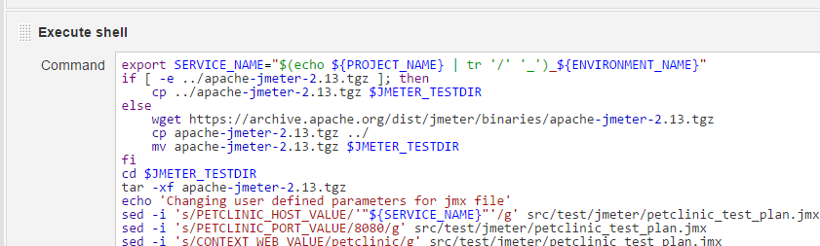
Challenges
Pipeline fails at performance testing job
Click on “Reference Application Performance Test” Job
Click on “configure” link to open the configuration
Go to the Jmeter configuration as shown below

Slide 39
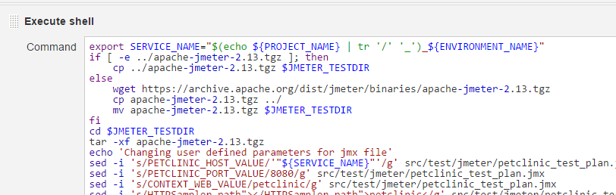
Challenges
Make sure that the link to get Jmeter is as
wget https://archive.apache.org/dist/jmeter/binaries
/apache-jmeter-2.13.tgz

Slide 40
Topic 4
Module 4 Activities: Quality Gates

Slide 41
Introduction
This lab is divided into 2 activities
Configuring Sonar-Qube for code analysis
Viewing various test reports

Slide 42
Sonar Profiles
Sonar is available from http://<public-ip>/sonar/sessions/login (or you can click on the link from the ADOP homepage)
Click on ‘Rules’ link to see configured rules for code analysis
To add/modify or view existing rules, navigate to the 'Quality Profiles' page
Click on the profile name to see a break down of all the rules set for that particular profile

Slide 43
Viewing Sonar Analysis For Project
Move to the dashboard by clicking on Dashboards → Home link
On the right pane, clink on link for project
DOA/Labs/Module2_Module3_FOSS_Java
Study the report for issues and settings for the project
You will observe that there are
2 critical
15 major and
7 minor issues

Slide 44
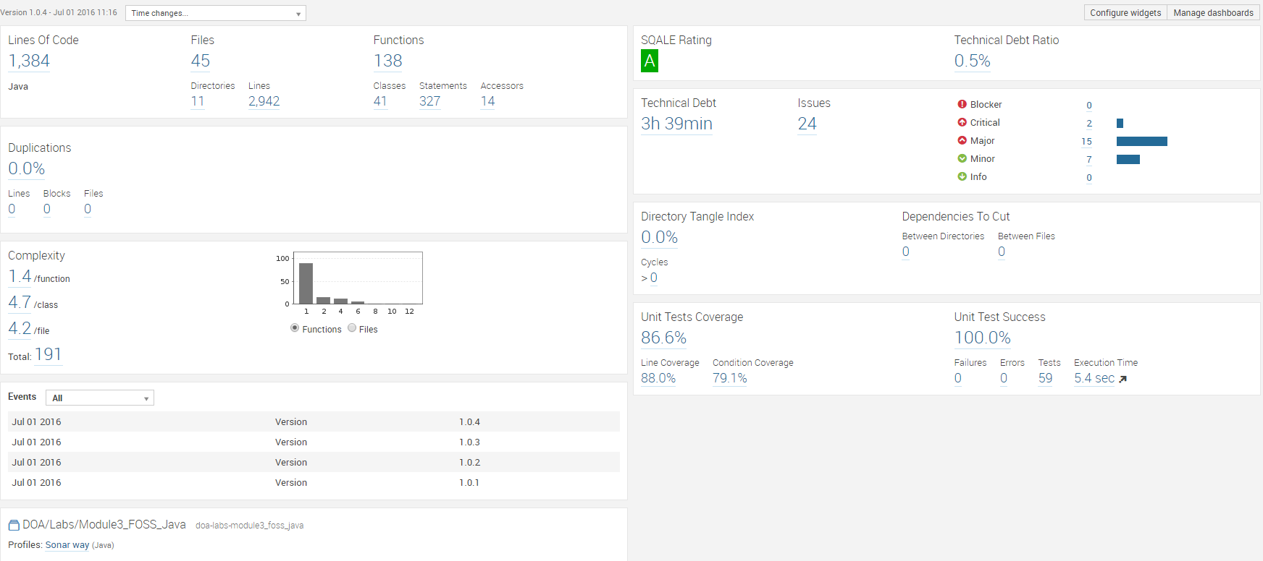
Project Status Report on Sonar

Slide 45
Defining Quality Gate
Go to Quality Gates (top bar)
Make following changes in quality gate ‘SonarQube Way’
Critical Issues → Value→ is greater than → 0 or 1 in error threshold field
then click the Update button (to the right)

Slide 46
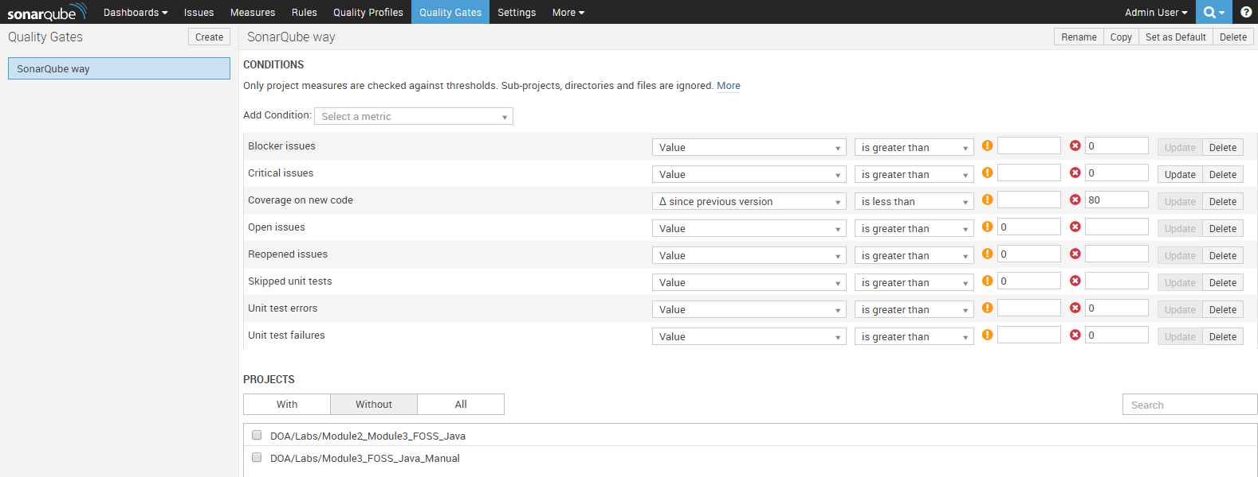
Quality Gate Configuration

Slide 47
Assigning Quality Gate To Project
Go to the Projects section below the gate configuration
Move to the ‘Without’ tab
To assign this gate to the "Module2_Module3_FOSS_Java" project, click on the checkbox next to the project name
This will move "Module2_Module3_FOSS_Java" from the Without category to With
You can confirm by checking it in project settings

Slide 48
Watching the Pipeline
Open Jenkins to see the pipeline
Move to DOA/Labs/Module 2 and 3 – FOSS_JAVA
Select Java Reference Application tab
Run the pipeline
Watch it failing on step3

Slide 49
Rectifying The Issue
Watch the project status on SonarQube
Click on the project link to drill down to exact offending piece of code
Click on “Critical issues 2>0”
You can change the quality gate or remove the project from quality gate so that pipeline will run successfully

Slide 50
View Cucumber Test Reports
Navigate to
http://DOA_Labs_Module2_Module3_FOSS_Java_CI.<public-ip>.xip.io/petclinic
Check that the Petclinic application is deployed
From the Jenkins job pipeline view, click the "Reference_Application_Regression_Tests“ for a successful step (green colored)
Click on the "Cucumber-JVM Reports" link
Click on features and observe it
E.g. Click on “Browsing Around” feature, then select “vets” scenario, and follow the steps in deployed application

Slide 51
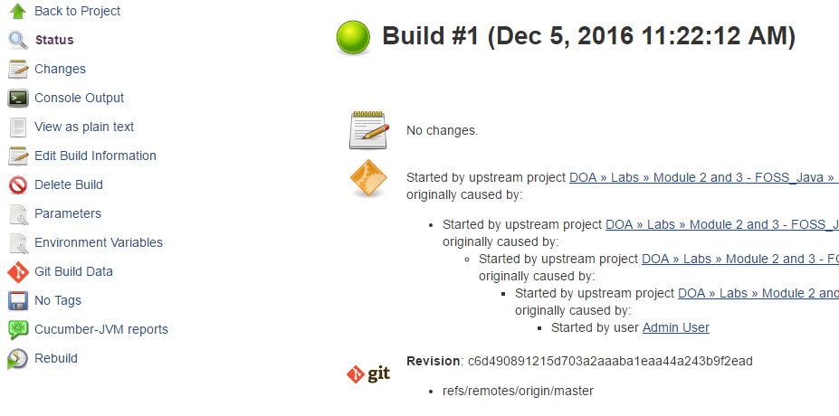
View Cucumber Test Reports

Slide 52
Making Cucumber Test Fail
Open the file spring-petclinic\src \main\webapp\WEB-INF\jsp\vets\vetList.jsp file
change line 18 from:
<h2>Veterinarians</h2>
to:
<h2>Vets</h2>
Push the change, causing the pipeline to be triggered:
git add .
git commit -m "Checking if unit tests are intact"
git push

Slide 53
Fixing the Problem
You have two choices here:
Fix the code to meet the definition of the feature (preferred)
Update the feature to match the code (bit more ugly because it implies our test went out of date and is annoying now)

Slide 54
Fixing the Code
Edit this file: src/main/webapp/WEB-INF/jsp/vets/vetList.jsp
On line 18 and change it from:
<h2>Vets</h2>
To:
<h2>Veterinarians</h2>
Add, Commit and Push the change
The test will now pass successfully

Slide 55
Update the Feature
Clone the adop-cartridge-java-regression-tests repository
git clone http://<user.name>@<public-ip>
/gerrit/DOA/Labs/Module2_Module3_FOSS_
Java/adop-cartridge-java-regression-tests
Navigate to the adop-cartridge-java-regression-tests project
Open src/test/java/springpetclinic_selenium/ cucumber/features/browsing_around.feature and change the scenario

Slide 56
Update the Feature
From:
Scenario: Vets
Given I am on the home page
-------
And I should see "Veterinarians" within h2
To:
Scenario: Vets
Given I am on the home page
-------
And I should see "Vets" within h2

Slide 57
Update the Feature
Push the Change to the repository:
git add .
git commit -m "fixed heading issue in Feature description"
git push
Re-run the pipeline

Slide 58
View Performance Test Reports
From the Jenkins job pipeline view, click the "Reference_Application_Performance_Tests“ for a successful step (green colored)
Click on the “Gatling" link
Click on “recordedSimulation” link
Click on “Open in a new window” link to observe it on full page
Note: Currently data is not available. Will check with DevOps team

Slide 59
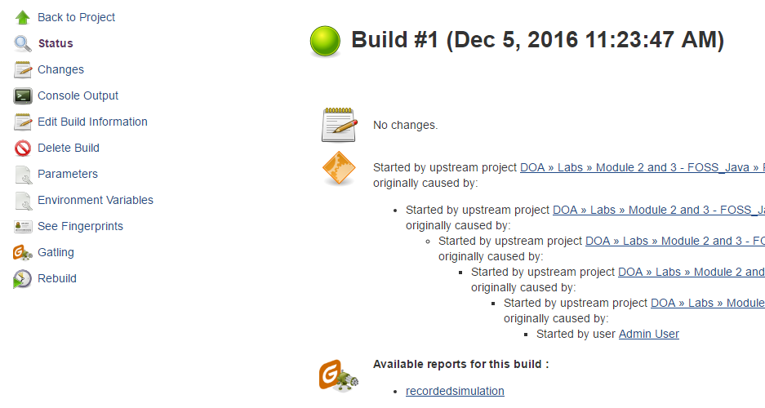
View Performance Test Reports

Slide 60
End Of Day1
We have come to the end of day and therefore need to trash all the environments and tools we created in the morning
By deleting the CloudFormation stack we will delete all VPC, subnets, IP addresses etc
Go to AWS Console:
Click on Services, click on CloudFormation
Select the stack you created this morning.
Click on ‘delete stack’ and wait for it to confirm that the stack is deleted.
Validate the deletion completes.
Instructors
Please ensure all stacks are deleted

Slide 61
Summary
At the end of this course, you are able to:
Create DOA gen5 stack using cloud formation
Use GIT as SCM for your project
View and use Jenkins as CI tool
Describe the Quality Gates in a pipeline

Slide 62
Reference
https://alm.accenture.com/wiki/display/DOT/Application+Deployment

Slide 63
Thank You

